Slide 1

4. Noise and Dimensionality (continued)
Dr. David R. Thompson
Jet Propulsion Laboratory, Imaging Spectroscopy Group
July 20, 2019

Slide 2
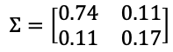
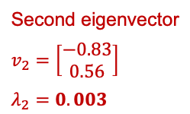
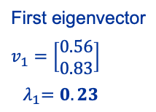
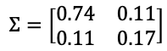
Principal component analysis
Finds new basis for efficiently representing data using vectors of a lower dimension, focusing on the linear subspace spanned by the process you are measuring. It finds the projection that maximizes the variances (i.e. the spread) of the projected dataset. The basis is given by the eigenvectors of the covariance matrix:
$$Σ=\left[\begin{matrix}0.74 & 0.11 \\ 0.11 & 0.17\end{matrix}\right]$$
$$Σ=\left[\begin{matrix}0.74 & 0.11 \\ 0.11 & 0.17\end{matrix}\right]$$
First eigenvector
$$v_{1}=\left[\begin{matrix}0.56 \\ 0.83\end{matrix}\right]$$
${ λ}_{1}=0.23$
channel 2
channel 2
Second eigenvector
$$v_{2}=\left[\begin{matrix}−0.83 \\ 0.56\end{matrix}\right]$$
$λ_{2}=0.003$
channel 1
channel 1

Slide 3
PCA Recipe
Convert the data to have zero mean
Form A using the top n eigenvectors of the sample covariance matrix XX^{T}
Equivalently, use the left singular vectors of X associated with the largest singular values
Project the data:
To reconstruct:
$$Σ=\left[\begin{matrix}0.74 & 0.11 \\ 0.11 & 0.17\end{matrix}\right]$$
$$Σ=\left[\begin{matrix}0.74 & 0.11 \\ 0.11 & 0.17\end{matrix}\right]$$
First eigenvector
$$v_{1}=\left[\begin{matrix}0.56 \\ 0.83\end{matrix}\right]$$
${ λ}_{1}=0.23$
channel 2
channel 2
Second eigenvector
$$v_{2}=\left[\begin{matrix}−0.83 \\ 0.56\end{matrix}\right]$$
$λ_{2}=0.003$
channel 1
channel 1

Slide 4
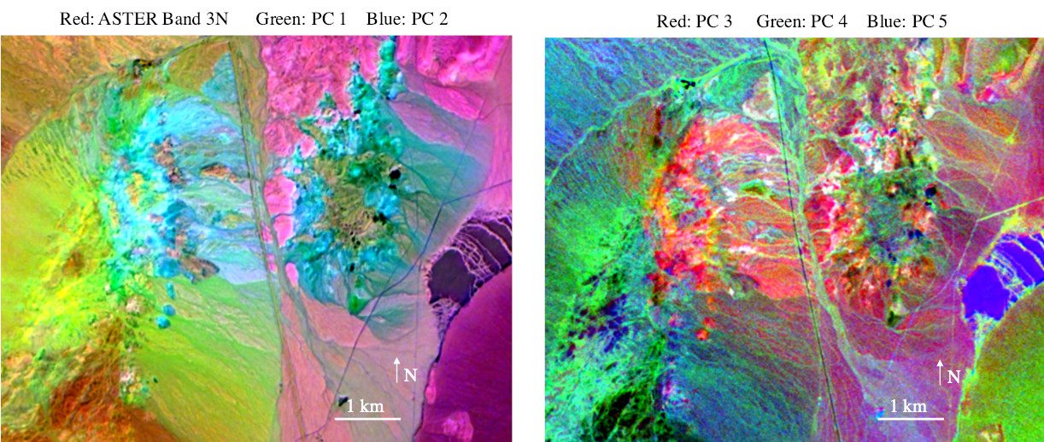
First 5 PCA dimensions of the of Cuprite Nevada mining district (AVIRIS-NG)
[Thompson et al., Astrobiology 2019]

Slide 5
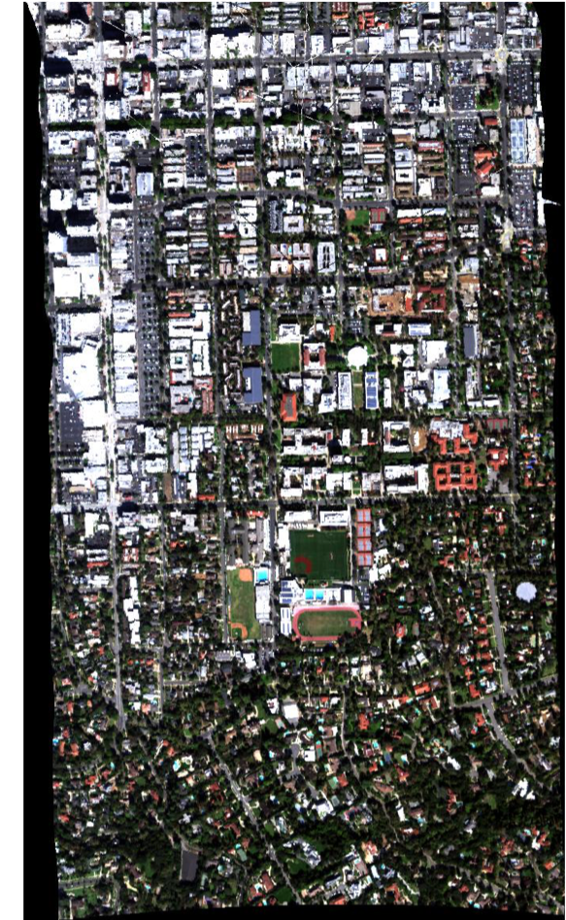
Practical Considerations: Bad data values
Most spectral data cubes have some locations for which spectra are invalid because of geoprojection effects, instrument configurations, etc.
In our system, these are flagged with floating point values of -9999. Be sure to exclude these locations from your statistics!
Note: bad data around margin due to geoprojection

Slide 6
Practical Considerations: Interleave
Spectral data cubes have three dimensions, leading to several potential index orderings.
The most common are:
Band Interleaved by Pixel (BIP): x[ row, column, channel ]
Band Interleaved by Line (BIL): x[ row, channel, column ]
Band Sequential (BSQ): x[ channel, row, column ]
Most data cube header files indicate the interleave as an ASCII text string. We store ours in BIL format, but occasionally translate to BIP for cleaner indexing syntax.

Slide 8
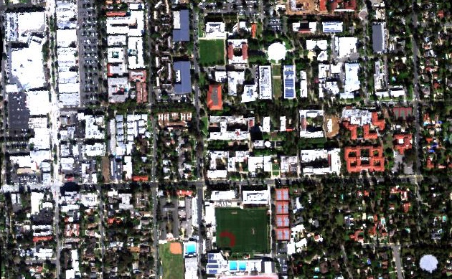
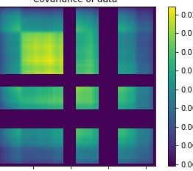
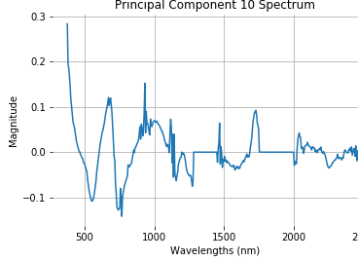
Exercise 4: Principal Component Analysis
N
100 m
Objective: Calculate Principal Components of the Caltech cube. Calculate mean spectra and the covariance matrix. Watch out for deep water features and bad data flags (values of -9999) at the periphery. You may not need all spectra in the calculation. Are any of the top PCs interpretable? If so, what do they represent?

Slide 9

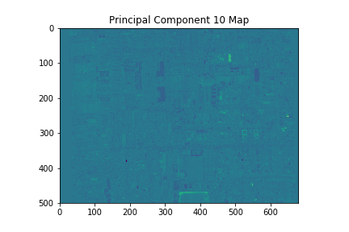
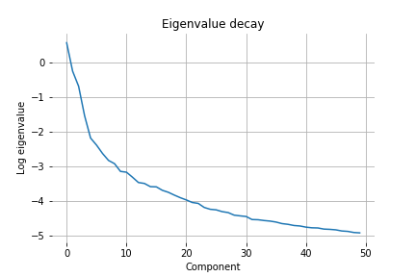
Bonus: Intrinsic dimensionality
N
Objective: Find the intrinsic dimensionality of the Caltech cube. Calculate principal components as before, and evaluate the eigenvalue decay. There are several ways one might find the noise level. For example:
Project each mean-removed spectrum onto the eigenvectors to make spatial maps. Then, visually determine the eigenvalues for which the spatial projection starts degenerating to noise.
Find a spatially-homogeneous area and use pixelwise differencing methods. I haven’t actually tried this yet, and it might be challenging due to the nature of the scene.
100 m

